Slide 1
Seeking Performance Portability on Graph Analytics
Bringing HPC Graph Analytics to
Modern Graph Databases
PPAM 2022
14th International Conference on Parallel Processing and Applied Mathematics
Sep 12, 2022
Ümit V. Çatalyürek
Amazon Scholar, Amazon Web Services
Professor, School of Computational Science and Engineering
Georgia Institute of Technology
Notes:
Disclaimer: All of the views presented in this talk represents my own views/comments, and not of my current employer AWS.

Slide 2
Outline
Motivation
Current Landscape of “Graph World”
Few Examples of HPC Graph Analytics
  HPC Graph Analytics - Tips/Tricks
  Faster centrality computations
    Graph manipulations for fast centrality [SDM’13, TKDD’17]
    Faster centrality computations on GPU [GPGPU’13]
    Vectorized centrality computations [MTAAP’14,JPDC’15]
A Middle Ground: Task-based Execution on Heterogeneous Environments
    Parallel Graph Algorithms by Blocks (PGAbB) [HPEC’19,TPDS'22,underreview]
What about Graph Databases
  Interoperability Challenges
  Design Challenges
Conclusions & Future Directions

Slide 3
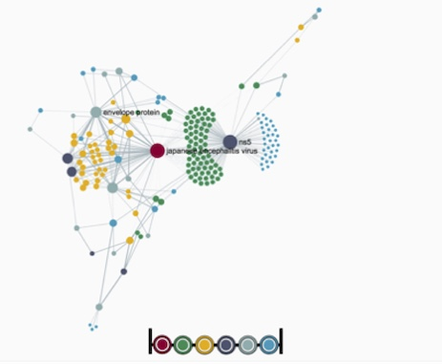
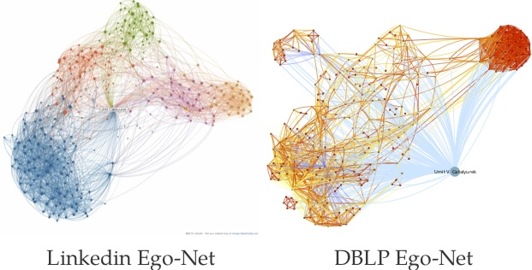
Graphs are Ubiquitous
They are growing. Up to billions of vertices and edges
Fast, efficient analysis is important and pervasive
Many graph processing frameworks, and databases, have been proposed/developed
Image credits:
Jenn Caulfield, Social network vector illustration, 2018
Albert-László Barabási/BarabasiLab 2019
Gerhard et al., Frontiers in Neuroinformatics 5(3), 2011
Caleb Jonson, How to Visualize Your Twitter Network, 2014
Notes:
Past decades witnessed unprecedented growth in the collection of data
Many of these datasets are semi-structured or unstructured and naturally they can be best modeled as graphs
Fast and efficient analysis is important and hence there have been many efforts to develop both hand optimized HPC graph algorithms and also graph processing framework.

Slide 4
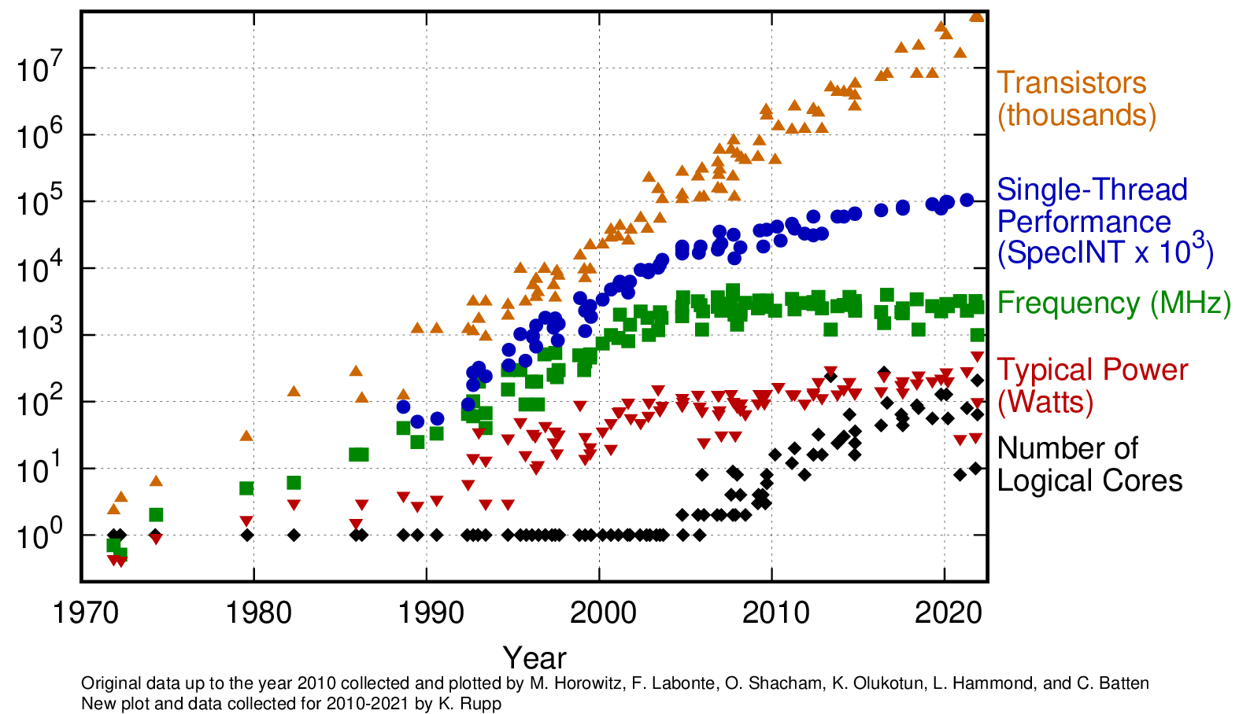
Why HPC - Hardware Motivation: 50 Years of Microprocessors
https://github.com/karlrupp/microprocessor-trend-data

Slide 5
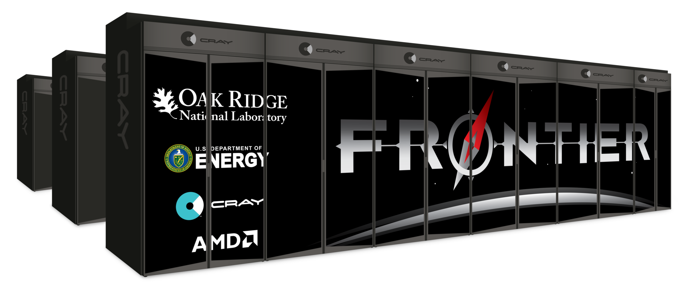
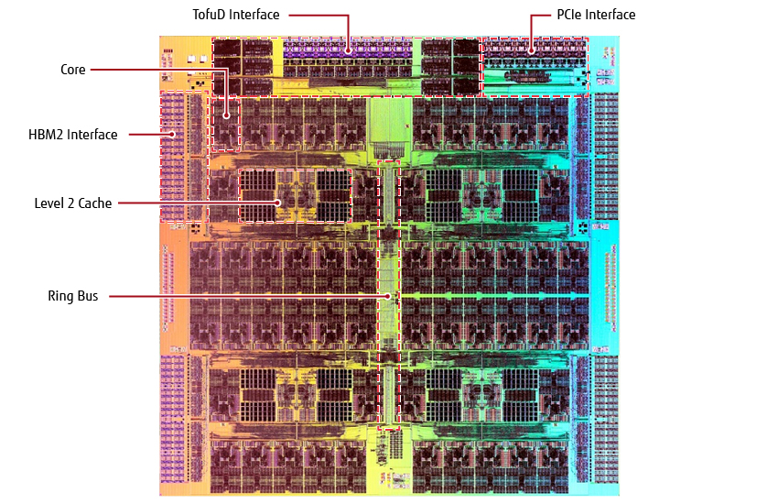
Why HPC - Hardware Motivation: Current & Future Systems
More and more machines composed of multi-core and many-core CPUs, and accelerators
June 2022: Top500’s top 10 has 9 with many-core CPU/Accelerators (7 GPUs, Maxtrix-2000, SW26010)
Some examples:
  Frontier: 8,730,112 cores (9,408 nodes)
    64-core AMD EPYC, 4 AMD MI250X GPUs
  Fugaku: 7,630,848 cores (>150K nodes):
    Fujitsu’s 48-core A64FX SoC
  Summit: 2,414,592 cores (4,608 nodes)
    2 IBM Power9 22 Cores, 6 NVIDIA Volta GV100
  Intel Xeon E7-8890 V4
    24 cores, 2 threads per core, 2 AVX 512 vector processing units/core
  SW26010 chip is a Chinese “homegrown” many-core (260 core) processor
    4 cluster of 64 CPEs+ 1 MPE
  NVIDIA A100
    6,912 cores, 432 tensor cores, 9.7 / 19.5 TFLOPS (FP64 / FP64 Tensor Core)
Cloud Instances also have ”similar” GPUs and and many-core CPUs.
Die photo of A64FX CPU

Slide 6
Outline
Motivation
Current Landscape of “Graph World”
Few Examples of HPC Graph Analytics
  HPC Graph Analytics - Tips/Tricks
  Faster centrality computations
    Graph manipulations for fast centrality [SDM’13, TKDD’17]
    Faster centrality computations on GPU [GPGPU’13]
    Vectorized centrality computations [MTAAP’14,JPDC’15]
A Middle Ground: Task-based Execution on Heterogeneous Environments
    Parallel Graph Algorithms by Blocks (PGAbB) [HPEC’19,TPDS'22,underreview]
What about Graph Databases
  Interoperability Challenges
  Design Challenges
Conclusions & Future Directions

Slide 7
Landscape of current “Graph World”
Enterprise Graph Frameworks
HPC Graph Analytics
Graph Databases

Slide 8
Scalability

Slide 9
Scalability

Slide 10
Scalability! But at what COST?
F. McSherry, M. Isard, and D. G. Murray, “Scalability! But at what COST?,” HotOS, 2015.

Slide 11
Productivity vs Performance
N. Satish, N. Sundaram, M. M. A. Patwary, J. Seo, J. Park, M. A. Hassaan, S. Sengupta, Z. Yin, and P. Dubey, “Navigating the maze of graph analytics frameworks using massive graph datasets”. SIGMOD 2014.
>100x

Slide 12
Outline
Motivation
Current Landscape of “Graph World”
Few Examples of HPC Graph Analytics
  HPC Graph Analytics - Tips/Tricks
  Faster centrality computations
    Graph manipulations for fast centrality [SDM’13, TKDD’17]
    Faster centrality computations on GPU [GPGPU’13]
    Vectorized centrality computations [MTAAP’14,JPDC’15]
A Middle Ground: Task-based Execution on Heterogeneous Environments
    Parallel Graph Algorithms by Blocks (PGAbB) [HPEC’19,TPDS'22,underreview]
What about Graph Databases
  Interoperability Challenges
  Design Challenges
Conclusions & Future Directions

Slide 13
HPC Graph Analytics - Tips/Tricks
It is almost all about data movement and maximizing data reuse/locality
  Smaller problems are easier to solve (and they take less memory space!)
    Reduce your problem size: Graph manipulations/compression
  Memory/Data Structures Optimizations
    Align (/reorder) to memory/compute architecture
    Make it memory hierarchy (cache) friendly
  Processor optimizations
    Take advantage of (instruction) parallelism (e.g., Vectorization, Tensor-Cores etc.)
      Well, sometimes non-work optimal algorithm (with redundant computation) runs faster!
  Hybrid (Memory + Processor)
    Task-based execution: 1D vs 2D tasks
    Task scheduling: pipelining, multi-buffering for computation and communication overlap
Eliminate “redundant” computation
  Can you reduce the solution space?
  Would approximation be appropriate/good?
  Can you sparsify?

Slide 14
Outline
Motivation
Current Landscape of “Graph World”
Few Examples of HPC Graph Analytics
  HPC Graph Analytics - Tips/Tricks
  Faster centrality computations
    Graph manipulations for fast centrality [SDM’13, TKDD’17]
    Faster centrality computations on GPU [GPGPU’13]
    Vectorized centrality computations [MTAAP’14,JPDC’15]
A Middle Ground: Task-based Execution on Heterogeneous Environments
    Parallel Graph Algorithms by Blocks (PGAbB) [HPEC’19,TPDS'22,underreview]
What about Graph Databases
  Interoperability Challenges
  Design Challenges
Conclusions & Future Directions

Slide 15
  Graph manipulations for fast centrality computations
  Let G = (V, E) be an undirected and unweighted graph with a vertex set V of n vertices and an edge set E of m edges
Closeness:
Betweenness:
O(mn) complexity for both metrics

Slide 16
  Graph manipulations for fast centrality computations

Slide 17
Closeness Centrality
SSSP: Single Source Shortest Path = BFS is computed for each vertex
BFS with farness computation
cc value is assigned
Notes:
Redo cut and paste. Insert pdf as picture

Slide 18
Betweenness Centrality
The current best algorithm (by Brandes)
  Phase 1: simple BFS with shortest path counting
  Phase 2: computing partial BC scores with counted paths

Slide 19
Graph Manipulations for Centrality with BADIOS

Slide 20
BC Experiments for BADIOS
36m
14m
1h38m
1h
12m
41s
2h
17m
1d8h
20h
12h
10h
1d18h
8h
5d5h
16h
BASE, o, do, dao, dbao, dbaio, dbaiso
[SDM’13, TKDD’17]

Slide 21
Outline
Motivation
Current Landscape of “Graph World”
Few Examples of HPC Graph Analytics
  HPC Graph Analytics - Tips/Tricks
  Faster centrality computations
    Graph manipulations for fast centrality [SDM’13, TKDD’17]
    Faster centrality computations on GPU [GPGPU’13]
    Vectorized centrality computations [MTAAP’14,JPDC’15]
A Middle Ground: Task-based Execution on Heterogeneous Environments
    Parallel Graph Algorithms by Blocks (PGAbB) [HPEC’19,TPDS'22,underreview]
What about Graph Databases
  Interoperability Challenges
  Design Challenges
Conclusions & Future Directions

Slide 22
How to implement Centrality Computations in GPU?
Vertex-based parallelism
  Assign a thread to each vertex
  When a thread processes a vertex u, if there exists an unvisited vertex w in u’s neighborhood, set d[w] = d[u] + 1
Edge-based parallelism
  Assign a thread to each edge
  For each edge (u,v), if u is in the current level and v is not visited yet set d[v] = d[u] + 1
Both has problems
  Vertex-based: load imbalance
  Edge-based: too many atomic operations

Slide 23
Centrality Computations on GPU: Virtual vertices
Use multiple virtual vertices for a vertex with high degree
  Hybrid edge/vertex parallelism.
Restructure computation to take advantage of coalesced memory access
u’
u
u’’

Slide 24
Results for GPU parallelism
VirBC-Multi (vectorized BC with Virtual Vertices) is better 6 out of 7
VirBC-Multi is 4.7x faster than Ligra, 1.6x faster than our CPU code
[GPGPU’13, JPDC’15]
Notes:
Hetero’s are not compared since it’s not fair

Slide 25
Outline
Motivation
Current Landscape of “Graph World”
Few Examples of HPC Graph Analytics
  HPC Graph Analytics - Tips/Tricks
  Faster centrality computations
    Graph manipulations for fast centrality [SDM’13, TKDD’17]
    Faster centrality computations on GPU [GPGPU’13]
    Vectorized centrality computations [MTAAP’14,JPDC’15]
A Middle Ground: Task-based Execution on Heterogeneous Environments
    Parallel Graph Algorithms by Blocks (PGAbB) [HPEC’19,TPDS'22,underreview]
What about Graph Databases
  Interoperability Challenges
  Design Challenges
Conclusions & Future Directions

Slide 26
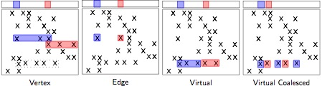
No Vector Coalescing
All the representations give vector coalescing only ``if you are lucky''

Slide 27
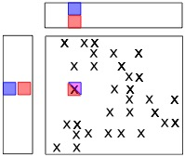
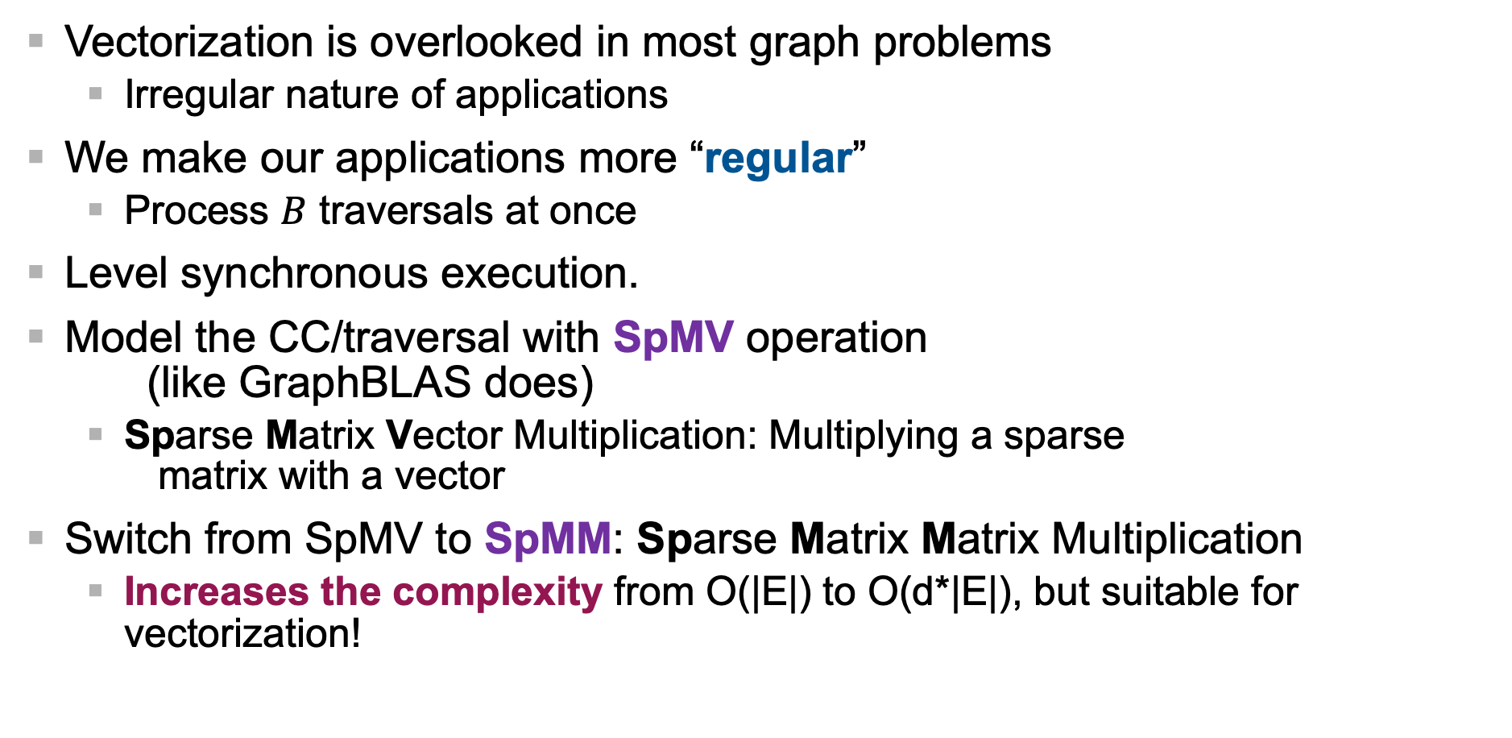
Different Formulation for Vectorization
Vectorization is overlooked in most graph problems
  Irregular nature of applications
We make our applications more “regular”
  Process $B$ traversals at once
Level synchronous execution.
Model the CC/traversal with SpMV operation (like GraphBLAS does)
  Sparse Matrix Vector Multiplication: Multiplying a sparse matrix with a vector
Switch from SpMV to SpMM: Sparse Matrix Matrix Multiplication
  Increases the complexity from O(|E|) to O(d*|E|), but suitable for vectorization!

Slide 28
Hardware+Software Vectorization is the way to go
Vectorized code (*-SpMM) is 5.9x faster in CPU, 21x in Xeon Phi,
70x on GPU (compared to previous best)
[MTAAP’14, JPDC’15]

Slide 29
Outline
Motivation
Current Landscape of “Graph World”
Few Examples of HPC Graph Analytics
  HPC Graph Analytics - Tips/Tricks
  Faster centrality computations
    Graph manipulations for fast centrality [SDM’13, TKDD’17]
    Faster centrality computations on GPU [GPGPU’13]
    Vectorized centrality computations [MTAAP’14,JPDC’15]
A Middle Ground: Task-based Execution on Heterogeneous Environments
    Parallel Graph Algorithms by Blocks (PGAbB) [HPEC’19,TPDS'22,underreview]
What about Graph Databases
  Interoperability Challenges
  Design Challenges
Conclusions & Future Directions

Slide 30
Parallel Graph Algorithms by Blocks (PGAbB)
How can we propose architecture agnostic graph algorithms that run well on shared-memory and heterogeneous systems as well as distributed-memory systems?
Block-based graph algorithms offer a sweet spot between efficient parallelism and architecture agnostic algorithm design
Parallel Graph Algorithms by Block (PGAbB)
Data/Computation Partitioning
Performance Portability
Block-Based Alg. Design
Notes:
Even though accelerators like GPUs have been extensively used for analysis, and even processing framework for GPUs have been developed, there is been a lack of graph processing system for heterogenous systems
This work aims to address that. We propose architecture agnostic graph analysis system. And our initial implementation is for shared-memory heterogenous systems.
Block-based algorithms offers a sweet spot between efficient parallelism and architecture agnostic algorithm design

Slide 31
Algorithm Design Steps
Generic and Custom
Block-List Generators.
Before
Iter.
After
Iter.
WorkEstim.
Host and Device
Kernels
Required
Optional
Notes:
A user who designs a new parallel algorithm would need to implement a few functors that will perform certain tasks. Their focus will be on the computational part of the algorithm not data move.
First, PGABbB will need to generate block list by using either a generic or custom block generator.
User should think ”what attributes” (for vertices, edges or global) are needed during the algorithm execution.
Then provide at least one functor for each “iteration” for execution handling. And most importantly provide two functors for host and device kernels. We utilize Kokkos underneath, so those kernels will not need to be very different.

Slide 32
Execution Flow
https://github.com/GT-TDAlab/SARMA
https://github.com/GT-TDAlab/PIGO
Notes:
Then execution flow is like this:
We start with PIGO reading data in parallel, and we partition the graph into blocks using symmetric rectilinear partitioning from SARMA. Layout manager handles the data as a set of blocks.
Then a functor (say P_{G}) generates the “tasks” which are simply a set block-lists with kernel functors. If needed, one can execute two functors I_{B} and I_{A} before and after each algorithm “iteration”. User could also choose to give work estimate for each ”task”. Then Scheduler schedules the execution on available resources.
And this process may be repeated for multiple iterations.

Slide 33
Categorizing Graph Algorithms
Dijkstra
Jaccard Rank
PageRank
MiniTri
Floyd-Warshall
HITS
kCore
BFS
Butterfly
Counting
kTruss
Shiloach-Vishkin
Triangle
Counting
Afforest
Single Block
Bulk Sync.
Activation
Based
Multi Block
Pattern Based
Notes:
We categorize the graph algorithms into three major, overlapping, categories
Single Block Bulk Synchronous algorithms
Activation based algorithms
Multi-block pattern algorithms
PageRank, Shiloach-Vishkin, Afforest algorithms are examples Single Block Bulk Synchronous algorithms.
BFS, Dijkstra are example of activation-based algorithms, where kcore for example fells in between those two categories
Last, we have multi-block pattern-based algorithms, examples include Jaccard Rank/Similarity, Floyd-Warshall, Triangle Counting etc.
And there are some algorithms that fell into intersections of those categories, like kCore, kTruss etc.
We have implemented 5 algorithms covering those categories in PGAbB those are marked with star.

Slide 34
Related Work
Frameworks in Our Experiments
GAPBS: Beamer, et al., 2015. “The GAP benchmark suite.”, ArXiV
Galois: Kulkarni, et al. 2007. “Optimistic parallelism requires abstractions”, PLDI
Ligra: Shun and Blelloch. 2013. “Ligra: a lightweight graph processing framework for shared memory”, PPoPP
LAGraph: Davis. 2019. “Algorithm 1000: SuiteSparse: GraphBLAS: Graph algorithms in the language of sparse linear algebra”, TOMS
Galois-GPU: Martin Burtscher, et al. 2012. “A quantitative study of irregular programs on GPUs”, IISWC
Gunrock: Wang, et al. 2016. ”Gunrock: A high-performance graph processing library on the GPU”, PPoPP
Notes:
For much detailed comparison of our framework with other computational frameworks, we have selected 6 state-of-the-art framework, 4 CPU ones, and 2 GPU ones.
Those include GAPBS, Galoi, Ligra, LAGraph, Galois-GPU and Gunrock.
We will present results taking GAPBS as the baseline for all frameworks.

Slide 35
Experiments on Selected Graphs
Power9 (2 x 16 x 4) CPUs & Volta100 GPU.
  320 GB Host Memory. 32 GB Device Memory.
  CPU-GPU bandwidth: ~60GB/s
PGAbB: Kokkos at the backend with OpenMP (Host) and Cuda (Device)
 | Number of
Graph | Vertices | Edges | Triangles | CC
Twitter7 | 41.6 M | 1.2 B | 34.8 B | 0.001
Com-Orkut | 3 M | 117 M | 627 M | 0.041
Sk-2005 | 50.6 M | 1.8 B | 84.9 B | 0.002
Kmer_V1r | 214 M | 232 M | 49 | 0.000
Europe-OSM | 50.9 M | 54.1 M | 61 K | 0.003
Myciel.19 | 393 K | 451 M | 0 | 0
Kron-Scale21 | 2.1 M | 91 M | 8.8 B | 0.044
Notes:
This is an eye exam slide, which I don't expect everyone to read all the numbers.
On this table, vertically we have the computational frameworks, starting Galois at the top and PGAbB at the boottom.
And horizontally we have the 7 different graphs.
For each framework we have 5 "algorithms' speedup performance relative to GAPBS. So greater than 1 is good and we used shades of green to highlight the magnitudes.
Less than 1 means framework is slower than GAPBS and we used shades of red to highlight the magnitudes. Here 0 means we couldn't run the algorithm on that framework, mostly due to memory limitations on GPU.
The take home message from this table, there is no single framework that is the "BEST" in all problems/algorithms and graphs. But as you can see PGAbB is the one that has most green, indicating it generally outperforms the other frameworks.

Slide 36
Outline
Motivation
Current Landscape of “Graph World”
Few Examples of HPC Graph Analytics
  HPC Graph Analytics - Tips/Tricks
  Faster centrality computations
    Graph manipulations for fast centrality [SDM’13, TKDD’17]
    Faster centrality computations on GPU [GPGPU’13]
    Vectorized centrality computations [MTAAP’14,JPDC’15]
A Middle Ground: Task-based Execution on Heterogeneous Environments
    Parallel Graph Algorithms by Blocks (PGAbB) [HPEC’19,TPDS'22,underreview]
What about Graph Databases
  Interoperability Challenges
  Design Challenges
Conclusions & Future Directions

Slide 37
Graph Databases
Two camps
LPG: Labeled Property Graphs
Vertices
Nodes: Label/ID + Properties (set of key-value pairs)
Edges
Relationships: Label/ID + Type + Properties
RDF: Resources Description Framework
Vertices
Resources: URIs
Attribute Values: Literals
Edges
Relationships: URIs
RDF Triple: Subject-Predicate-Object
There is no internal structure for nodes and edges
Notes:
RDF stands for Resource Description Framework and it’s a W3C standard for data exchange in the Web.
It’s an exchange model that represents data as a graph.
The RDF model is more about data exchange and the LPG is purely about storage and querying.

Slide 38
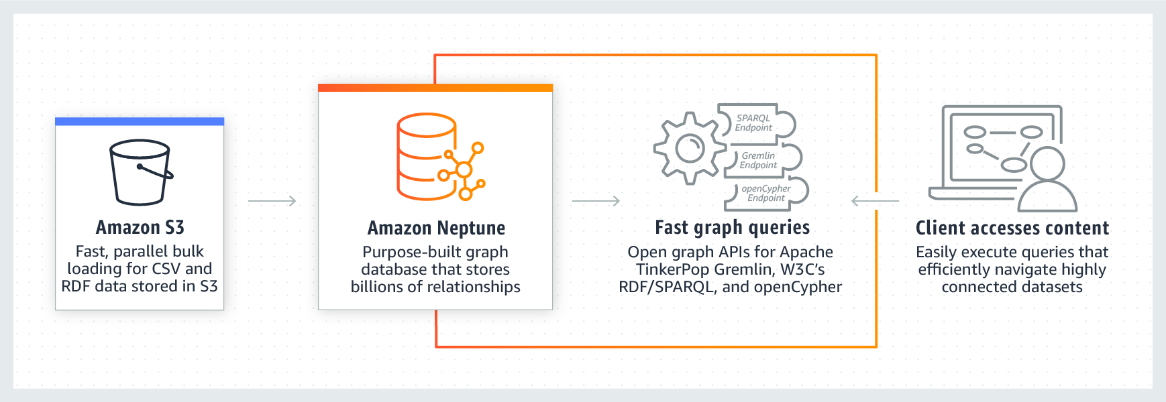
Graph interoperability
Amazon Neptune
  managed, cloud-based graph database service
  supports RDF (SPARQL) and LPG (Gremlin & openCypher)
User has to choose either RDF or LPG
  this choice also determines which query languages are available
  the choice is not always easy, and is hard to reverse later
RDF vs. LPG
  RDF offers a formal model, LPG not so much
  RDF is “sometimes seen as academic”, and developers tend to prefer LPG
  different strengths and weaknesses

Slide 39
Graph interoperability
What if we did not have to choose between RDF and LPG?
What if we could use Gremlin over RDF, or SPARQL over LPG?
Interoperability: single graph (meta)model, free use of any query language
  we are not interested in “qualified” interoperability where one metamodel is implemented using the other
RDF-star is a step towards having LPG features in RDF
1G model (“one graph to rule them all”)
  "Graph? Yes! Which one? Help!", O. Lassila, M. Schmidt, B. Bebee, D. Bechberger, W. Broekema, A. Khandelwal, K. Lawrence, R. Sharda, B. Thompson, arXiv:2110.13348v1, 2021.

Slide 40
Interoperability challenges
Edge properties, multiple edge instances, reification
Triples vs. graph abstraction
Datatype alignment
Graph partitioning
Graph merging, external identifiers
Lack of formal foundation
Update query semantics
The Neptune team seek support from the broader community to look into these issues

Slide 41
Storage Challenges
Interoperability: serve both RDF and LPG
  1G Graph Storage
Graph is not static (well, obviously!)
  Many HPC Graph Analytics kernels assumes graph is not changing.
  Even dynamic ones conveniently ignores deletion.
Scalability: Scaling Up (vertical/single-node) and Scaling Out (horizontal/multi-node)
  Read scaling is “easy”
  Write scaling with transaction support is challenging:
    Distributed in-memory graph storage with logging is still challenging to implement.
  How to (dynamically) distribute data
    Node partition vs Edge partition vs Blocked partition
What does it mean to provide Graph Analytics under transactional system?
Notes:
Brad “[1G] It is not a panacea, but it enables us to bring the features from different models together in way that customers choose what they need for their applications; it is a critical piece of the graph with confidence. ”

Slide 42
Computational Infrastructure Challenges
Interoperability: serve multiple query languages and graph analytics
Can we implement once, and run everywhere: from multi-core to multi-host with potentially accelerators?
Yes!
  Multi-Level Intermediate Representation (MLIR) for Graphs
  Event-based runtime system
  “Coarse-grained” Labeled-Dataflow Execution
OLAP vs OLTP tradeoffs and Scheduling
  multiple, mixed (OLAP and OLTP), concurrent queries.

Slide 43
Other Challenges
Where does the Graph come from?
Authoring
Toolkits
Visualization
TCO: Total Cost of Ownership
  Price/performance and price/scale options.

Slide 44
Conclusions & Future Directions
Graphs ubiquitous and market is growing extremely fast
  “By 2025, graph technologies will be used in 80% of the data and analytics innovations, up from 10% in 2021, facilitating rapid decision making across the enterprise” Gartner “Market Guide: Graph Database Management Solutions”, M. Adrian, A. Jaffri, D. Feinberg, 24 May 2021.
HTAP (i.e., Hybrid OLTP and OLAP) solutions are needed!
  Enterprise Graph Systems gives the illusion of read scaling, while failing in absolute performance, and write/update scaling (they just leave that to file system)
  HPC Graph Analytics codes/libraries, are one-off, focused on narrow set of kernels and fail to provide end-to-end solutions
  Existing “Real” Graph Databases, provides OLTP but fails to deliver OLAP
Interoperability is a big challenge!
  SPARQL, Gremlin and OpenCypher queries for both OLTP and OLAP workloads
Graph as a Service
It is exciting times for Graphs!

Slide 45
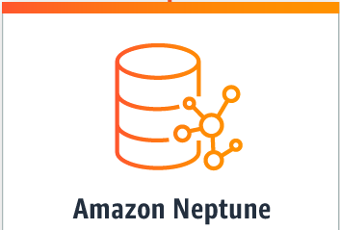
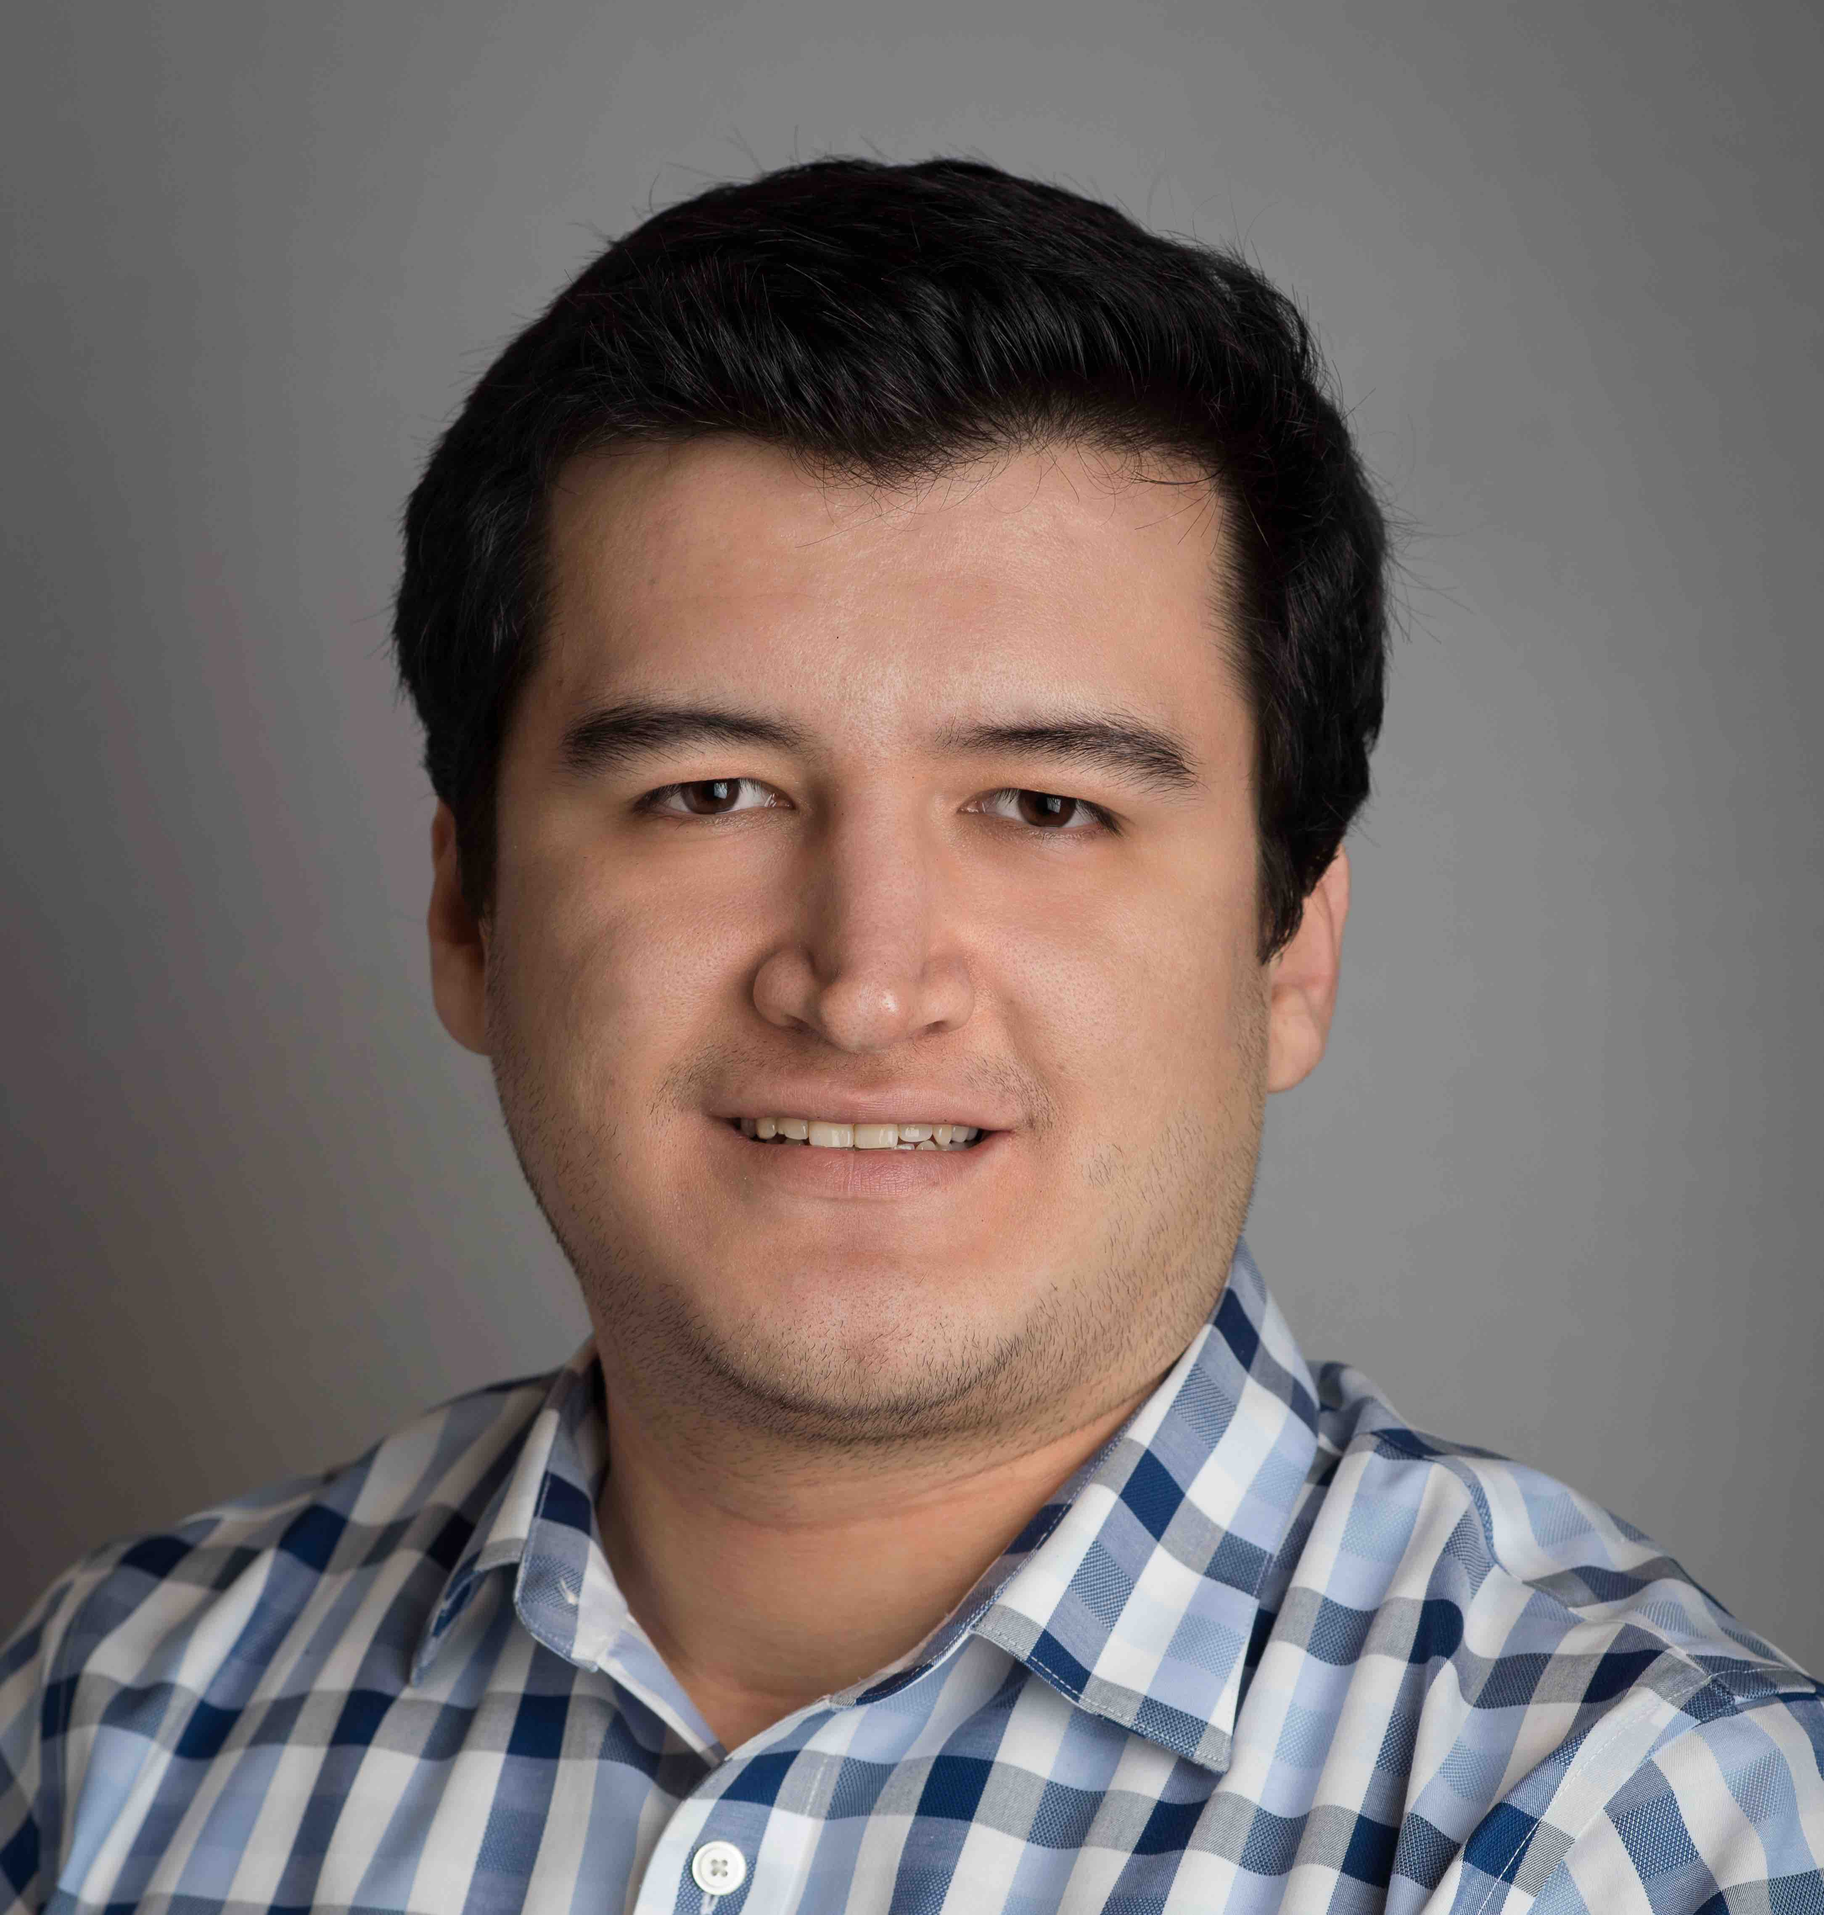
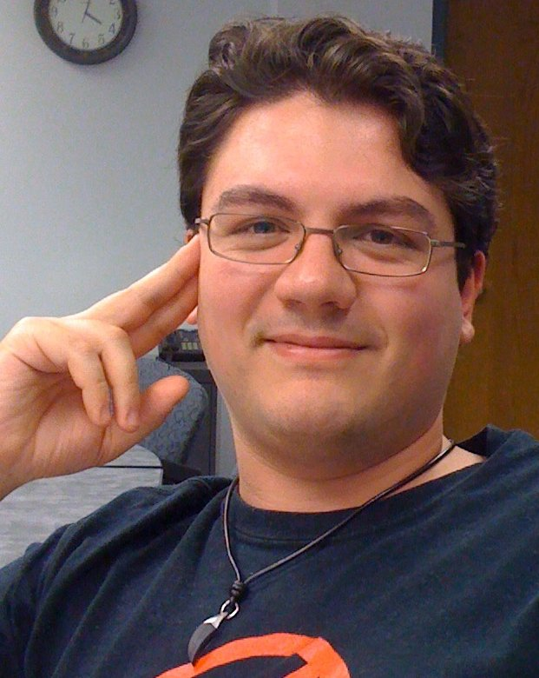
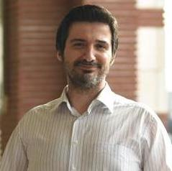
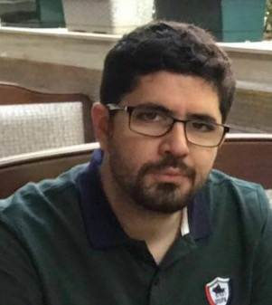

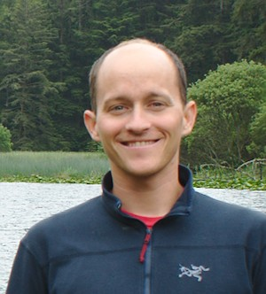
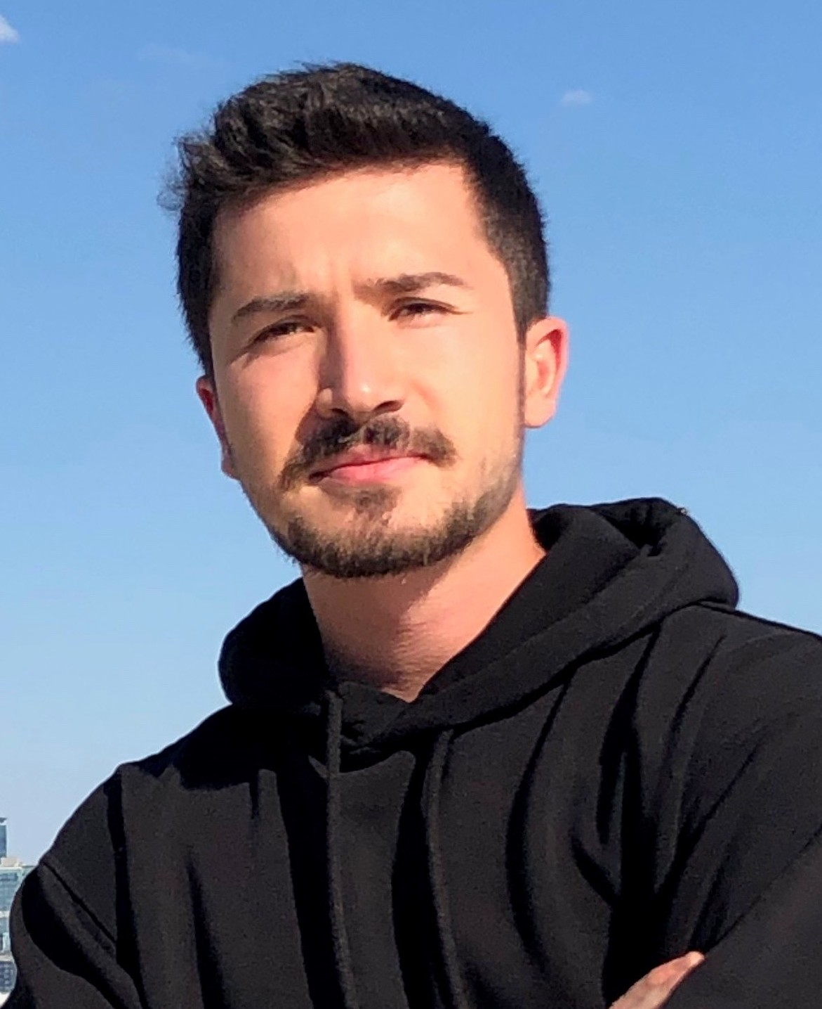
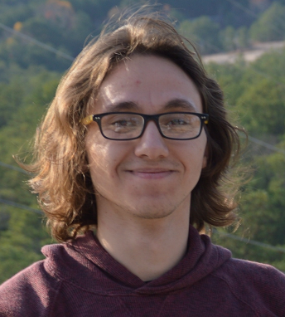
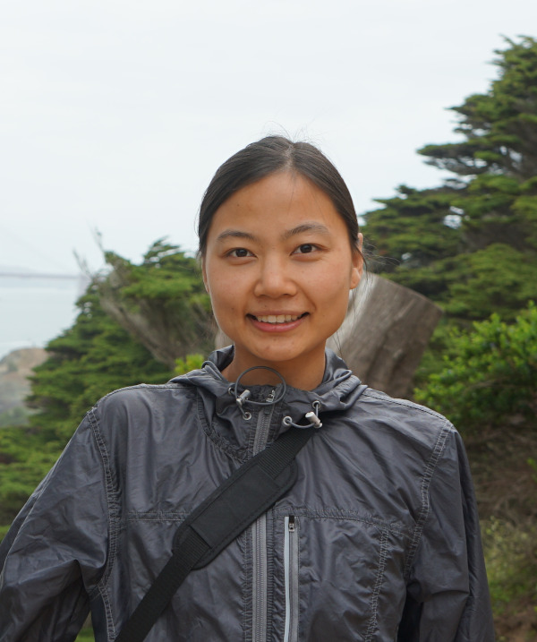
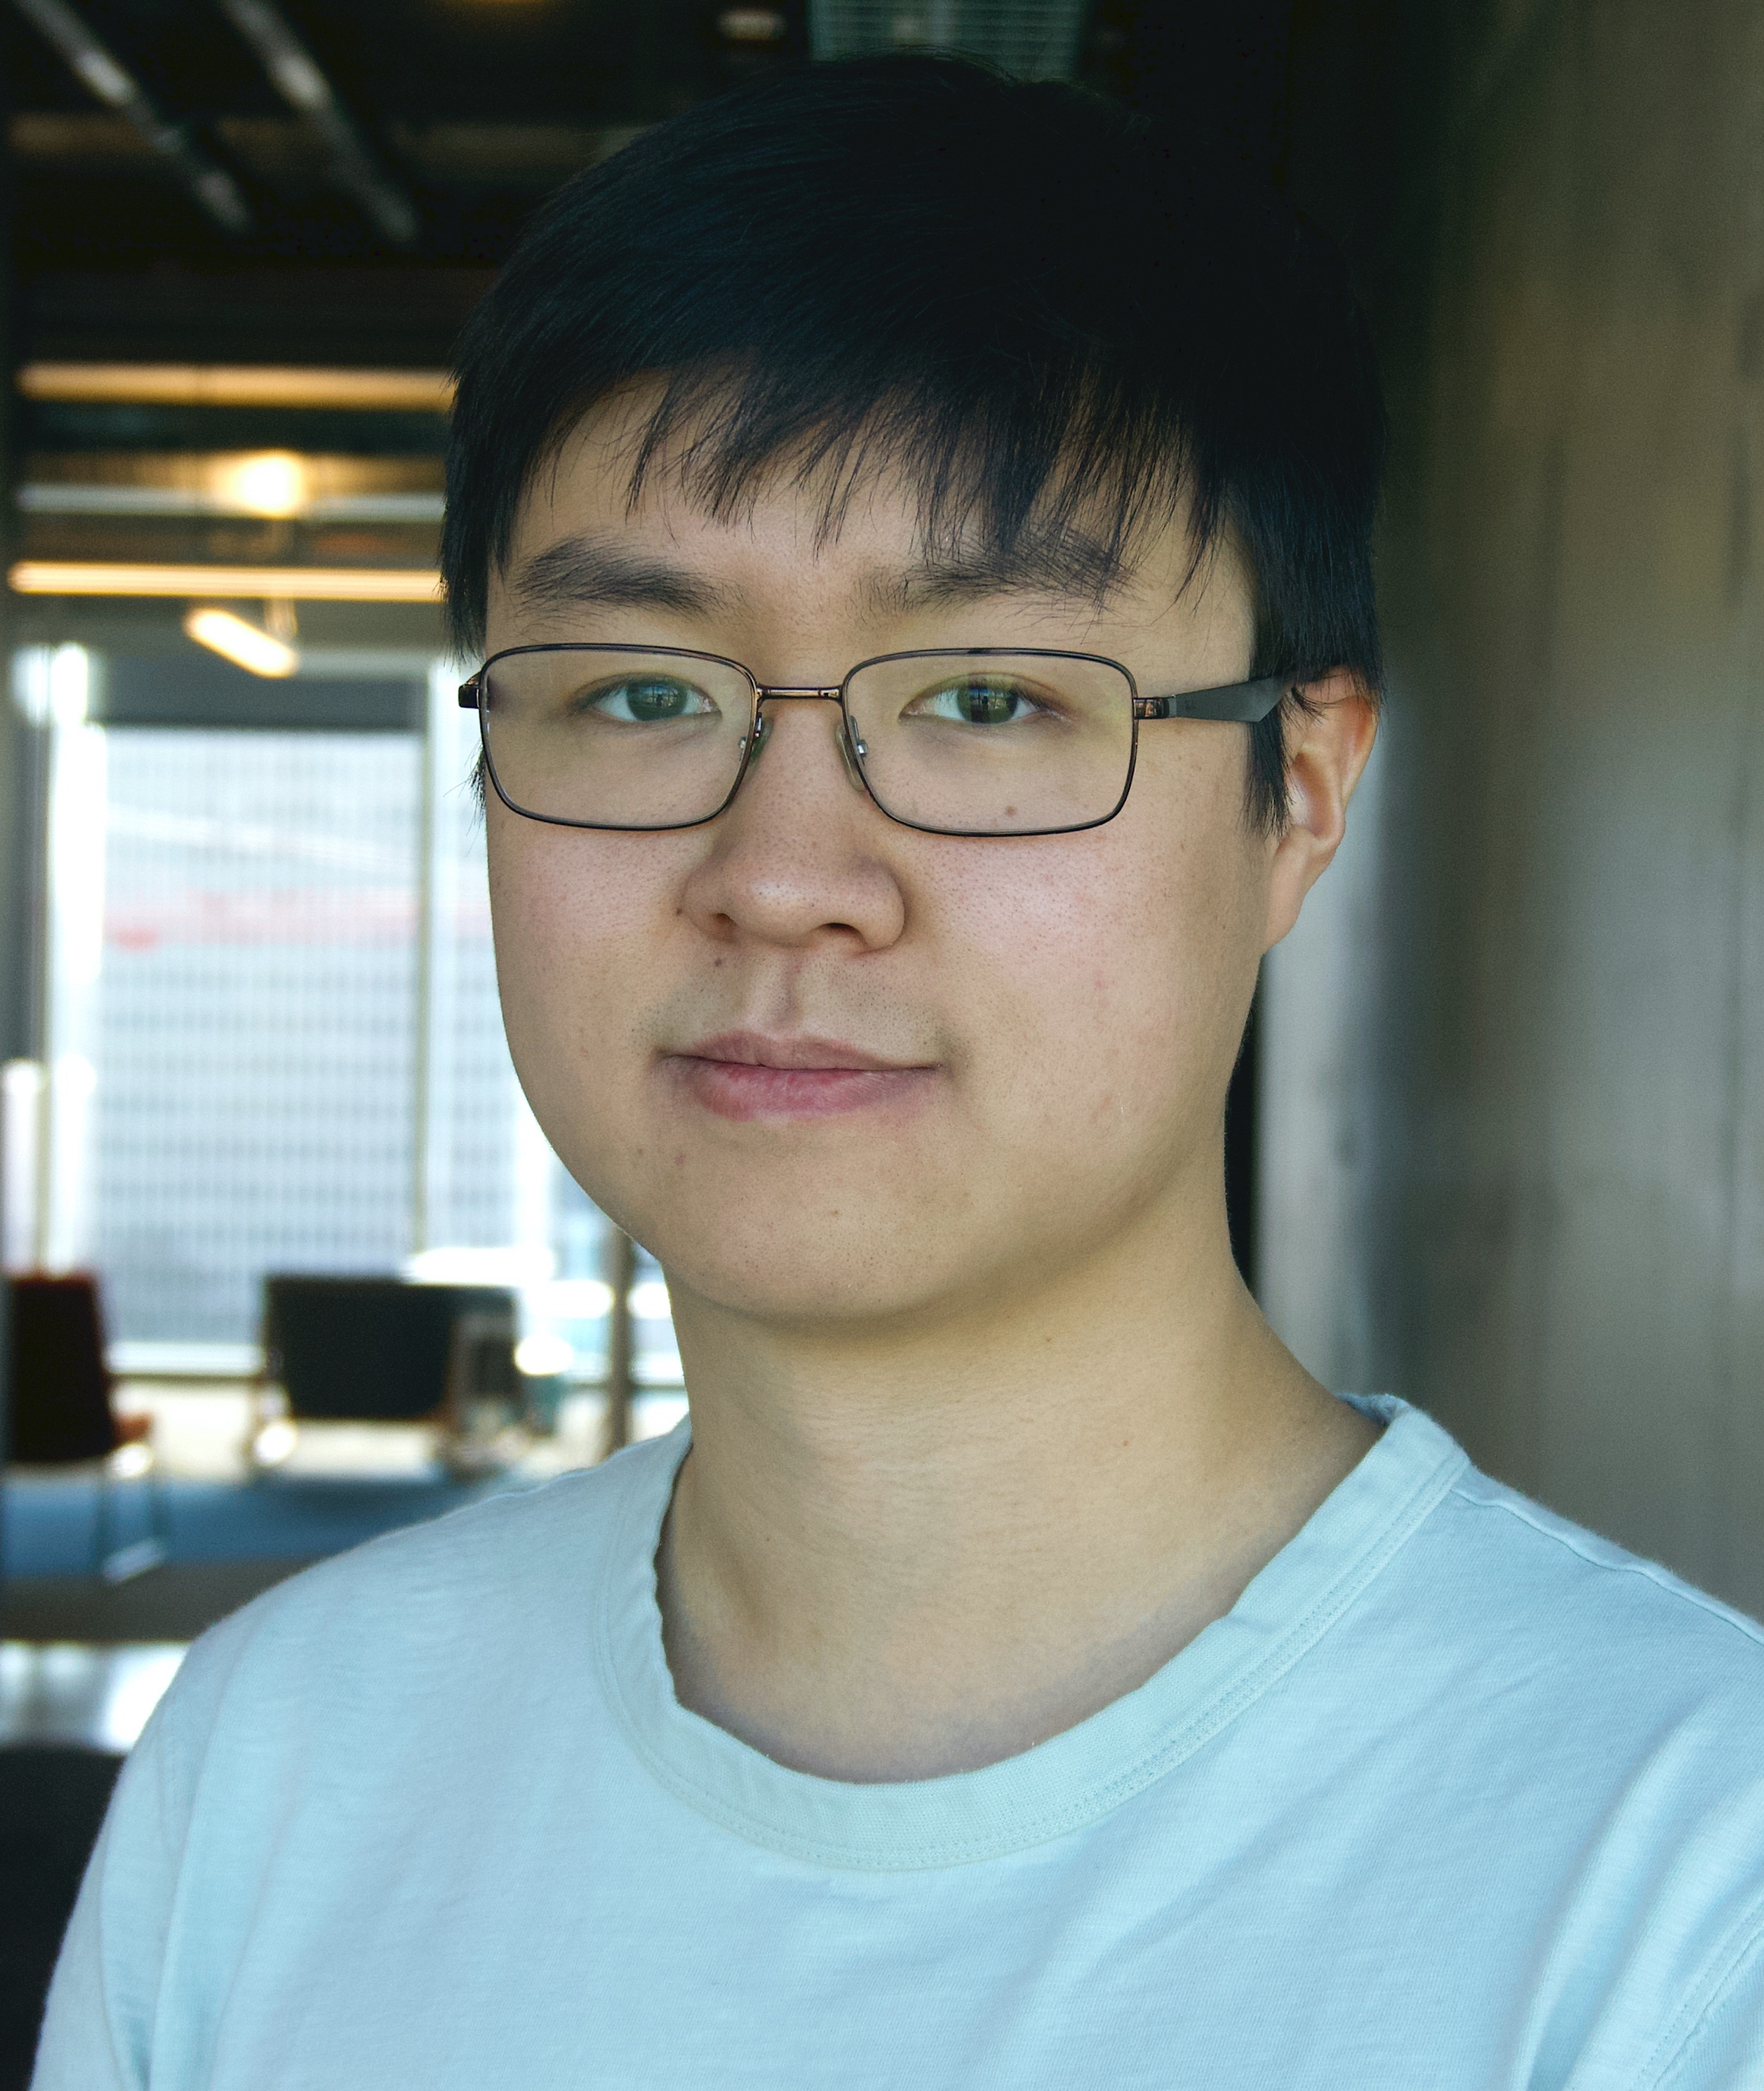


Acknowledgements – TDAlab Members and Collaborators
Centrality
PGAbB
Amazon Neptune
Team
Erdem
Sarıyüce
Erik
Saule
Kamer
Kaya
Abdurrahman
Yaşar
Sivasankaran
Rajamanickam
Jonathan
Berry
(Other) TDAlab Members
Ümit V.
Çatalyürek
Kasimir
Gabert
Kaan
Sancak
Yusuf
Özkaya
Xiaojing
An
James
Fox
Fatih
Balin
Benjamin
Cobb

Slide 46
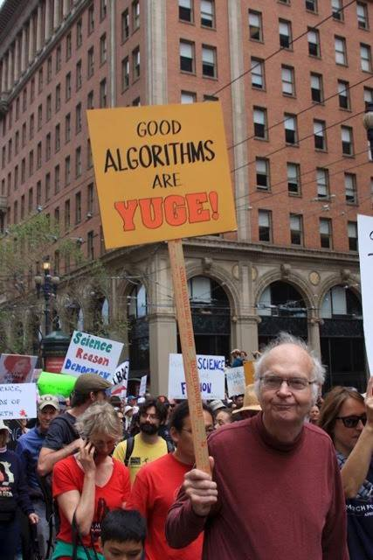


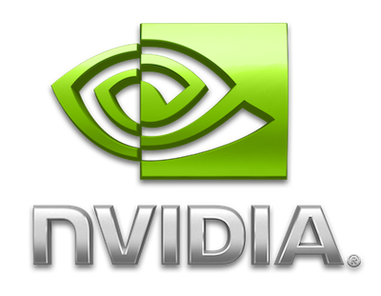

Thanks
For more information
  email: umit@gatech.edu
  twitter: @catalyurek
  web: tda.gatech.edu
Acknowledgement of (Previous) Support
parallel graph
Notes:
Please feel free to reach out to me and our lab members for any questions and comments.

Slide 47
References
  [SDM’13] A.E. Sarıyüce, E. Saule, K. Kaya, and Ü.V. Çatalyürek, “Shattering and Compressing Networks for Betweenness Centrality”, 13th SIAM International Conference on Data Mining (SDM), May 2013.
  [TKDD’17] A.E. Sarıyüce, K. Kaya, E. Saule, and Ü.V. Çatalyürek, “Graph Manipulations for Fast Centrality Computation”, ACM Transactions on Knowledge Discovery from Data, Vol. 11, No. 3, Apr 2017.
  [GPGPU’13] A.E. Sarıyüce, K. Kaya, E. Saule, and Ü.V. Çatalyürek, “Betweenness Centrality on GPUs and Heterogeneous Architectures”, Workshop on General Purpose Processing Using GPUs (GPGPU), in conjunction with ASPLOS, Mar 2013.
  [MTAAP’14] A.E. Sarıyüce, E. Saule, K. Kaya, and Ü.V. Çatalyürek, “Hardware/Software Vectorization for Closeness Centrality on Multi-/Many-Core Architectures”, Proceedings of 28th IPDPSW, W. on Multithreaded Architectures and Applications (MTAAP), May 2014.
  [JPDC’15] A.E. Sarıyüce, E. Saule, K. Kaya, and Ü.V. Çatalyürek, “Regularizing Graph Centrality Computations”, Journal of Parallel and Distributed Computing, Vol. 76, pp. 106-119, Feb 2015.
[HPEC’18] A. Yaşar, S. Rajamanickam, M.M. Wolf, J. W. Berry, and Ü.V. Çatalyürek, “Fast Triangle Counting Using Cilk”, High Performance Extreme Computing Conference (HPEC), Sep 2018.
[HPEC’19] A. Yaşar, S. Rajamanickam, J. W. Berry, M.M. Wolf, J. Young, and Ü.V. Çatalyürek, “Linear Algebra-Based Triangle Counting via Fine-Grained Tasking on Heterogeneous Environments”, High Performance Extreme Computing Conference (HPEC), Sep 2019.
[TPDS'22] A. Yaşar, S. Rajamanickam, J. W. Berry, and Ü.V. Çatalyürek, “A Block-Based Triangle Counting Algorithm on Heterogeneous Environments”. IEEE Transactions on Parallel and Distributed Systems, 2022.
See http://tda.gatech.edu/publications for links/slides/PDFs.

Slide 48
Amazon Neptune – We are hiring!
Amazon Neptune is hiring! If you are excited by the possibility of building the internals of one of the fastest growing graph databases in the world, look no further! We're looking for some fearless SDEs to work on cutting edge technologies and core foundations of HPC, distributed transaction management, graph databases, algorithms and many more. (Locations: US, CAN, GER, IND)
Visit www.amazon.jobs and search “Neptune” for more info on multiple positions/openings.
Contact: uvc@amazon.com

