Slide 1
From Principles to Capabilities - the Birth and Evolution of High Throughput Computing
Miron Livny
Wisconsin Institutes for Discovery
Madison-Wisconsin

Slide 2
The lessons of the past and the illusions of predictions

Slide 3
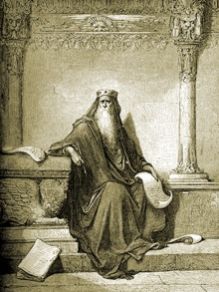
The words of Koheleth son of David, king in Jerusalem ~ 200 A.D.
Only that shall happen
Which has happened,
Only that occur
Which has occurred;
There is nothing new
Beneath the sun!
Ecclesiastes Chapter 1 verse 9
Ecclesiastes, (קֹהֶלֶת, Kohelet, "son of David, and king in Jerusalem" alias Solomon, Wood engraving
Gustave Doré (1832–1883)

Slide 4
The Talmud says in the name of Rabbi Yochanan,
“Since the destruction of the Temple, prophecy has been taken from prophets and given to fools and children.”
(Baba Batra 12b)

Slide 5
In 1996 I introduced the distinction between High Performance Computing (HPC) and High Throughput Computing (HTC) in a seminar at the NASA Goddard Flight Center in and a month later at the European Laboratory for Particle Physics (CERN). In June of 1997 HPCWire published an interview on High Throughput Computing.

Slide 6
High Throughput Computing is a 24-7-365 activity and therefore requires automation
FLOPY ≠ (60*60*24*7*52)*FLOPS

Slide 7
“The members of the Open Science Grid (OSG) are united by a commitment to promote the adoption and to advance the state of the art of distributed high throughput computing (DHTC) – shared utilization of autonomous resources where all the elements are optimized for maximizing computational throughput.”

Slide 8
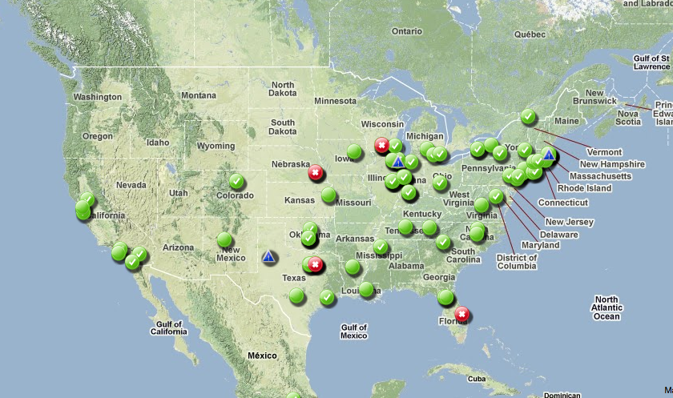
Open Science Grid (OSG)
National HTComputing
Notes:
8

Slide 9
Scientific Computing for the 21st Century
Workshop on HPC and Super-computing for Future Science Applications
June 6, 2013
Richard Carlson
Richard.Carlson@science.doe.gov

Slide 10
Traditional Scientific Computing Issues
Tussle between High Performance Computing and High Throughput Computing
Capability vs Capacity
Tussle between Grid / Cloud / Distributed computing
What are the differences between grid and cloud
Tussle between hardware ownership and software services
Who owns and manages the hardware vs the deployed services
Tussle between basic research and sustained deployment activities
How to balance research with sustainability

Slide 11
In 1978 I fell in love with the problem of load balancing in distributed systems

Slide 12
Claims for “benefits” provided by Distributed Processing Systems
P.H. Enslow, “What is a Distributed Data Processing System?” Computer, January 1978
High Availability and Reliability
High System Performance
Ease of Modular and Incremental Growth
Automatic Load and Resource Sharing
Good Response to Temporary Overloads
Easy Expansion in Capacity and/or Function

Slide 13
Definitional Criteria for a Distributed Processing System
P.H. Enslow and T. G. Saponas “”Distributed and Decentralized Control in Fully Distributed Processing Systems” Technical Report, 1981
Multiplicity of resources
Component interconnection
Unity of control
System transparency
Component autonomy

Slide 14
Unity of Control
All the component of the system should be unified in their desire to achieve a common goal. This goal will determine the rules according to which each of these elements will be controlled.

Slide 15
Component autonomy
The components of the system, both the logical and physical, should be autonomous and are thus afforded the ability to refuse a request of service made by another element. However, in order to achieve the system’s goals they have to interact in a cooperative manner and thus adhere to a common set of policies. These policies should be carried out by the control schemes of each element.

Slide 16
It is always a tradeoff that forces us to strike a balance

Slide 17
In 1983 I wrote a Ph.D. thesis – “Study of Load Balancing Algorithms for Decentralized Distributed Processing Systems”
http://www.cs.wisc.edu/condor/doc/livny-dissertation.pdf

Slide 18
BASICS OF TWO M/M/1 SYSTEMS
When utilization is 80%,
you wait on the average 4 units
for every unit of service
λ
λ
When utilization is 80%,
25% of the time a customer is
waiting for service while
a server is idle
μ
μ

Slide 19
Should I stay or should I move?

Slide 20
In 1985 I extended the scope of the distributed load balancing problem to include “ownership” of resources

Slide 21
Should I share my resources and if I do with whom, when (and at what price)?

Slide 22
AWS Spot Instances and Google ExaCycle are recent examples from the private sector

Slide 23
Now you have customers who are resource consumers, resource providers or both

Slide 24
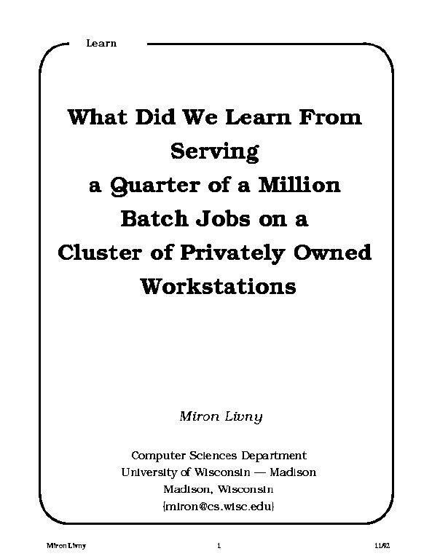
1992

Slide 25
Submit Locally and run Globally (Here is the work I need to get done and here are the resources I bring to the table)

Slide 26
1994 Worldwide Flock of Condors
Amsterdam
3
30
200
10
Delft
3
3
3
Madison
Warsaw
10
10
Geneva
Dubna/Berlin

Slide 27
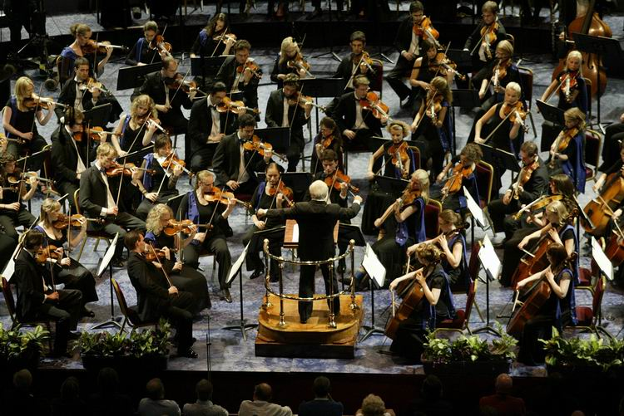
HTC on the UW campus
760 million
hours
100 million
hours
.03 million
hours
Desktop
UW-Madison CHTC
Open Science Grid
Notes:
HTC with Condor provides a single entry point to local as well as remote resources…
Over 54 researchers across 35 departments used over 45 million compute hours from campus resources in 12 months. 1.2 million came from OSG.
The OSG provides almost 1.3M compute hours each day, running almost 500k jobs. UW CHTC users get 24,000 of those hours on an average day.
Cycle spun up 10,000 cores for Genetech for 8 hours at a cost of $1,060/hour.
Google is offering a billion hours of computing for 10 researchers for a year.

Slide 28
Subject: Meeting request
From: Michael Gofman <michael.gofman@gmail.com>
Date: Thu, 16 May 2013 11:47:50 -0500
To: MIRON LIVNY <MIRON@cs.wisc.edu>
Dear Miron,
I am an assistant professor of finance at UW-Madison. I did my Phd at the University of Chicago and master degrees at the Tel Aviv University.
In the last couple months I was using HTC resources that you developed to compute optimal financial architecture.
I would like to meet with you and tell you more about my project as well to thank you personally for developing this amazing platform.
Yours,
Michael

Slide 29
Experimental Computer Science where you and other scientists are the

Slide 30
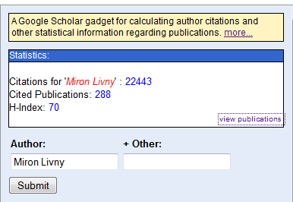

Slide 31
Dear Professor Livny,
I'm writing to you as I wish to invite you to a panel we're organizing at the next ECCS 2012 on "Experiments in Computer Science: Are Traditional Experimental Principles Enough?”
I was present during your ECSS presentation last year in Milan on "Experimental Computer Science and Computing Infrastructures" and, actually, was the person who asked you about a more scientifically oriented notion of experiment.
I must confess that your talk, and the discussion I had with some colleagues after, was ones of the driving forces behind the organization of this panel and a pre-summit workshop (also on experiments in computer science So it would be really fantastic if you would be interested in participating in the panel.

Slide 32
Edsger Dijkstra once stated: "Computer science is no more about computers than astronomy is about telescopes."
Research Methods for Science By Michael P. Marder page 14. Published by Cambridge University Press

Slide 33
Abstract. We examine the philosophical disputes among computer scientists concerning methodological, ontological, and epistemological questions: Is computer science a branch of mathematics, an engineering discipline, or a natural science? Should knowledge about the behavior of programs proceed deductively or empirically? Are computer programs on a par with mathematical objects, with mere data, or with mental processes? We conclude that distinct positions taken in regard to these questions emanate from distinct sets of received beliefs or paradigms within the discipline:
Eden, A. H. (2007). "Three Paradigms of Computer Science". Minds and Machines 17 (2): 135–167.

Slide 34
Real and hard Computer Science problems are exposed when you do it for “real”

Slide 36
You have Impact!

Slide 37
“Why are you leaving academia and taking a job in industry?” “I want to have impact!”

Slide 38
Solving “real-life” end-to-end problems makes you hype resistance

Slide 40
Perspectives on Grid Computing
Uwe Schwiegelshohn Rosa M. Badia Marian Bubak Marco Danelutto
Schahram Dustdar Fabrizio Gagliardi Alfred Geiger Ladislav Hluchy
Dieter Kranzlmüller Erwin Laure Thierry Priol Alexander Reinefeld
Michael Resch Andreas Reuter Otto Rienhoff Thomas Rüter Peter Sloot Domenico Talia Klaus Ullmann Ramin Yahyapour Gabriele von Voigt
We should not waste our time in redefining terms or key technologies: clusters, Grids, Clouds... What is in a name? Ian Foster recently quoted Miron Livny saying: "I was doing Cloud computing way before people called it Grid computing", referring to the ground breaking Condor technology. It is the Grid scientific paradigm that counts!

Slide 41
How do we prepare for the HTC needs of 2020?

Slide 42
Scientific Collaborations at Extreme-Scales: dV/dt - Accelerating the Rate of Progress towards Extreme Scale Collaborative Science Collaboration of five institutions – ANL, ISI, UCSD, UND and UW Funded by the Advanced Scientific Computing Research (ASCR) program of the DOE Office of Science

Slide 43
“Using planning as the unifying concept for this project, we will develop and evaluate by means of at-scale experimentation novel algorithms and software architectures that will make it less labor intensive for a scientist to find the appropriate computing resources, acquire those resources, deploy the desired applications and data on these resources, and then manage them as the applications run. The proposed research will advance the understanding of resource management within a collaboration in the areas of: trust, planning for resource provisioning, and workload, computer, data, and network resource management.”

Slide 44
“Over the last 15 years, Condor has evolved from a concept to an essential component of U.S. and international cyberinfrastructure supporting a wide range of research, education, and outreach communities. The Condor team is among the top two or three cyberinfrastructure development teams in the country. In spite of their success, this proposal shows them to be committed to rapid development of new capabilities to assure that Condor remains a competitive offering. Within the NSF portfolio of computational and data-intensive cyberinfrastructure offerings, the High Throughput Computing Condor software system ranks with the NSF High Performance Computing centers in importance for supporting NSF researchers.”
A recent anonymous NSF review

Slide 45
“… a mix of continuous changes in technologies, user and application requirements, and the business model of computing capacity acquisition will continue to pose new challenges and opportunities to the effectiveness of scientific HTC. … we have identified six key challenge areas that we believe will drive HTC technologies innovation in the next five years.”
Evolving resource acquisition models
Hardware complexity
Widely disparate use cases
Data intensive computing
Black-box applications
Scalability

Slide 46
The value of sustained experimental Computer Science

